Slide 1
PREDICTING LIVER DISEASES USING CLASSIFICATION MODELS
(GROUP 5 )

Slide 2
PROJECT MILESTONES
Introduction
Applications
Data Preprocessing
Exploratory Data Analysis
Data Visualization
Model Selection
Model Evaluation
Conclusion

Slide 3
INTRODUCTION
This project focuses on employing classification models to predict various liver diseases, offering a non-invasive and data-driven alternative to traditional diagnostic methods. Leveraging diverse datasets and advanced algorithms, the goal is to develop an accurate and interpretable tool for early identification and risk stratification, revolutionizing liver disease diagnostics. The project's outcomes hold the promise of enhancing healthcare practices and contributing to proactive, personalized interventions for individuals at risk of developing liver diseases.

Slide 4
APPLICATION
Early Diagnosis and Intervention
Patient Risk Stratification
Resource Optimization
Public Health Planning
Clinical Trials & Research
Health Insurance Risk Assessment
Health and Wellness Apps
Educational Campaign
Population Health Management

Slide 5
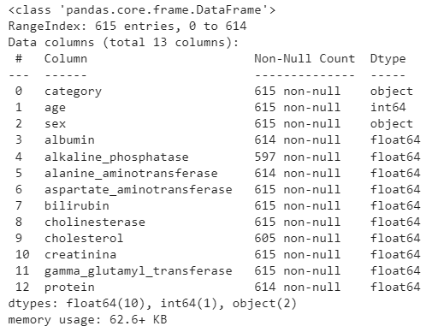
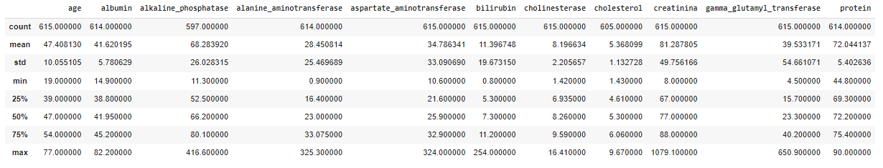
DATA PREPROCESSING
DATA OVERVIEW
(for raw data)
DESCRIPTIVE STATISTICS
(for raw data )

Slide 6
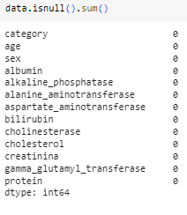
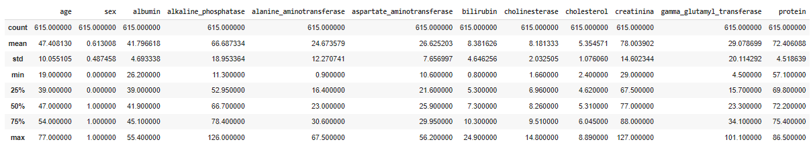
After Data Imputation
DATA OVERVIEW
DESCRIPTIVE STATISTICS

Slide 7
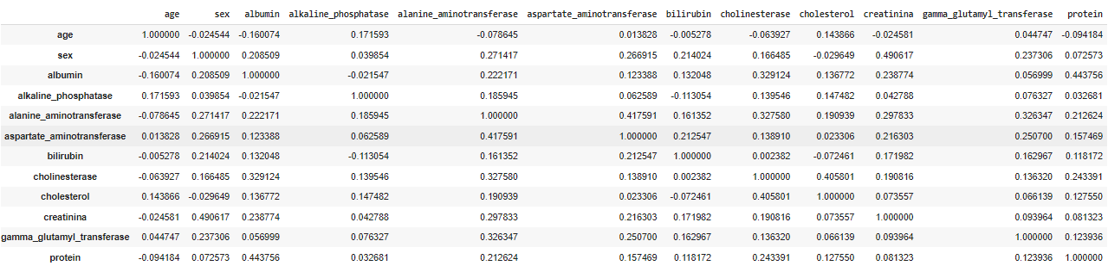
EXPLORATORY DATA ANALYSIS
CORRELATION ANALYSIS

Slide 8
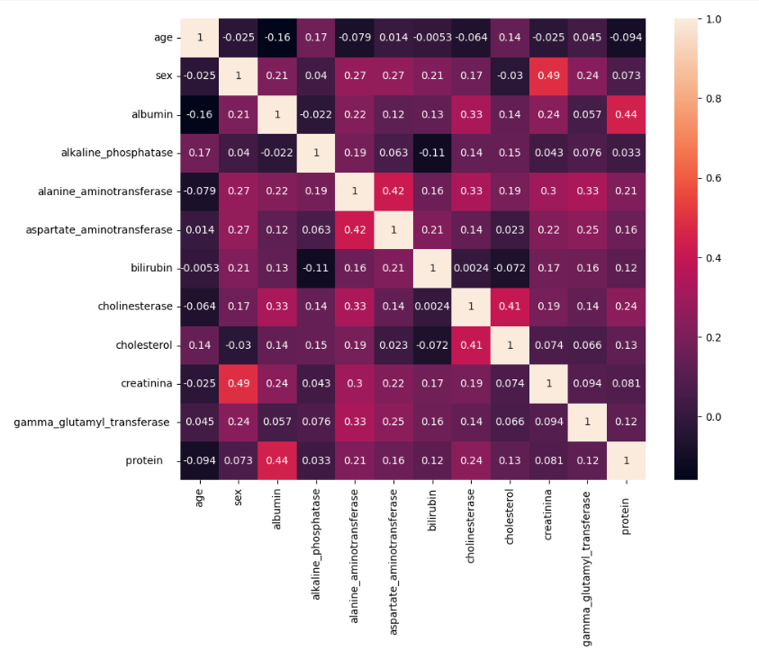
CORRELATION - HEATMAP

Slide 9
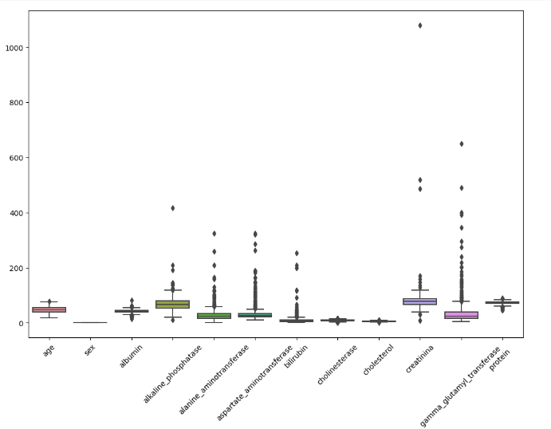
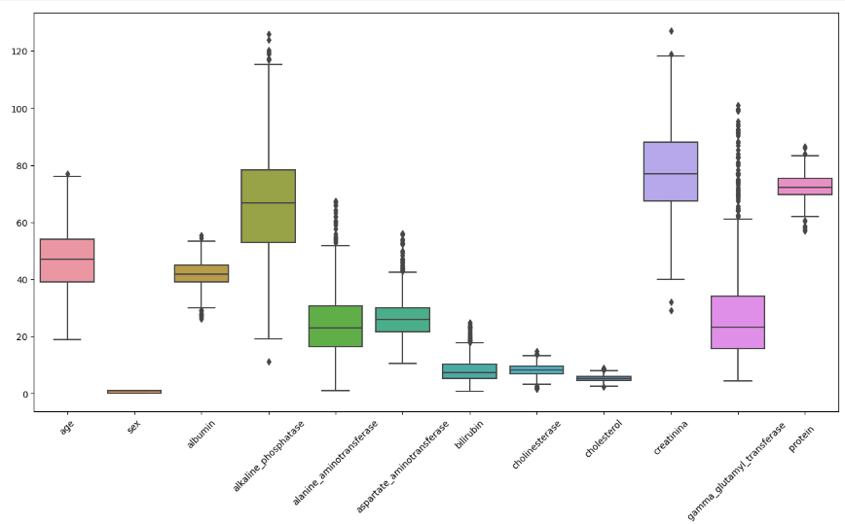
OUTLIER ANALYSIS
OUTLIER TREATMENT

Slide 10
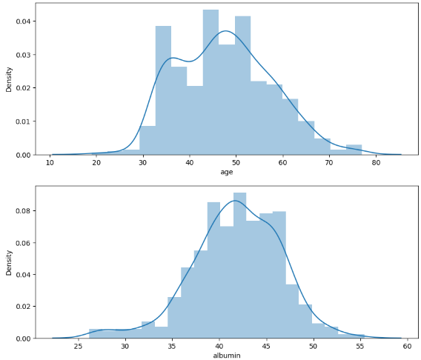
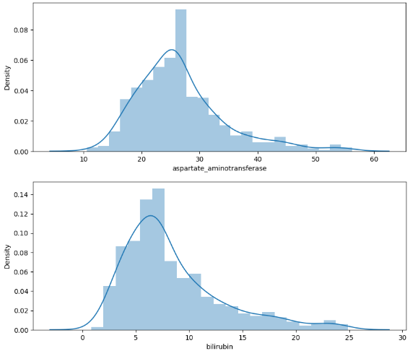
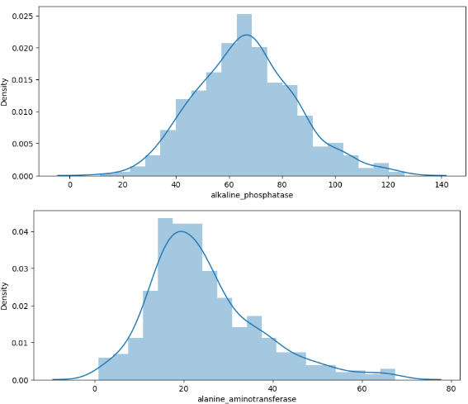
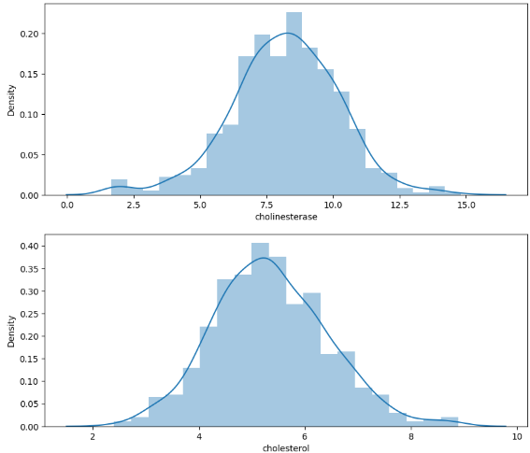
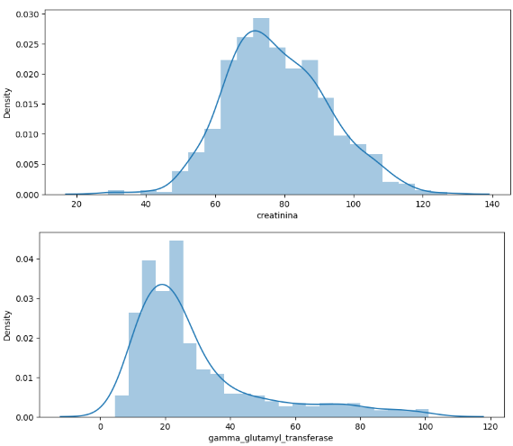
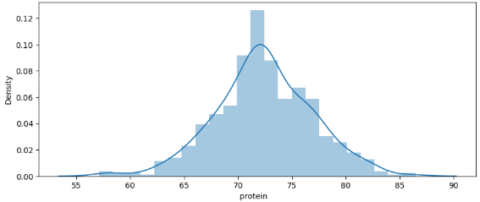
DATA VISUALIZATION
DISTRIBUTION PLOT

Slide 11
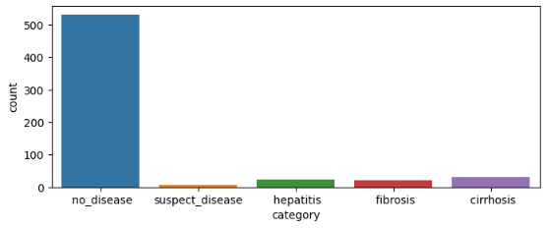
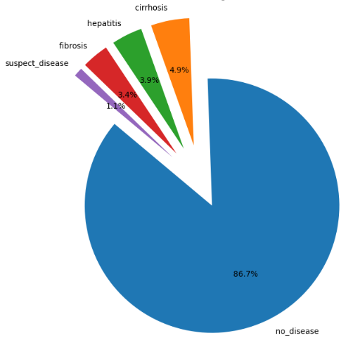
COUNT PLOT
PIE CHART
The plots shows that there is imbalance in data. We need to balance it.

Slide 12
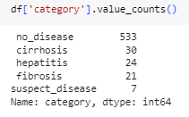
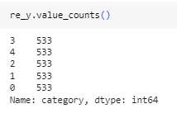
BALANCING DATA
Value Count of Cleaned Data
Values Count of Balanced Data
We used Random Over Sampler for balancing the data.

Slide 13
MODEL SELECTION
For this project we have tried the following models:
Logistic Regression
Random Forest
Support Vector Classifier(SVC)
Decision Tree
Naive Bayes
Auto ML(H2O)

Slide 14
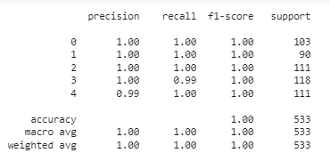
Random Forest Classifier

Slide 15
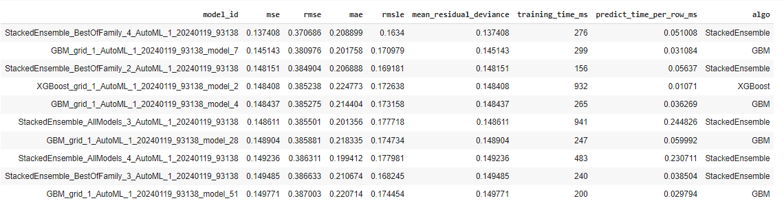
AutoML

Slide 16
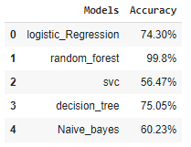
MODEL EVALUATION
As per the table we can see that the Accuracy of Random Forest Model is the best
and hence we used that for our Deployment.

Slide 17
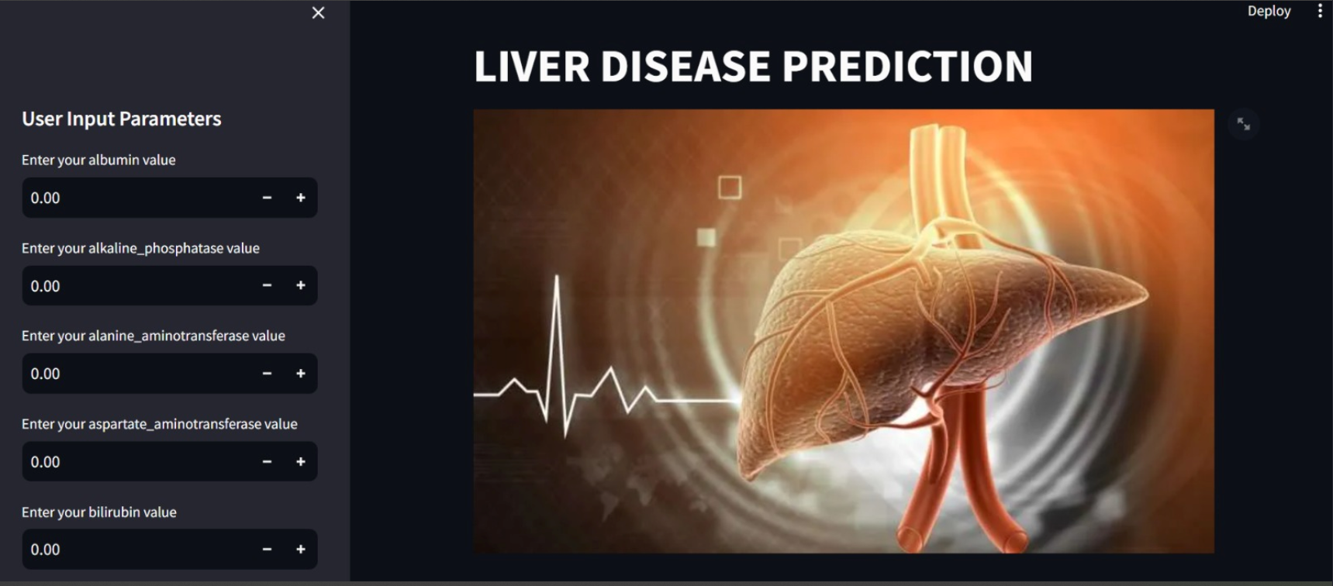
DEPLOYMENT

Slide 18
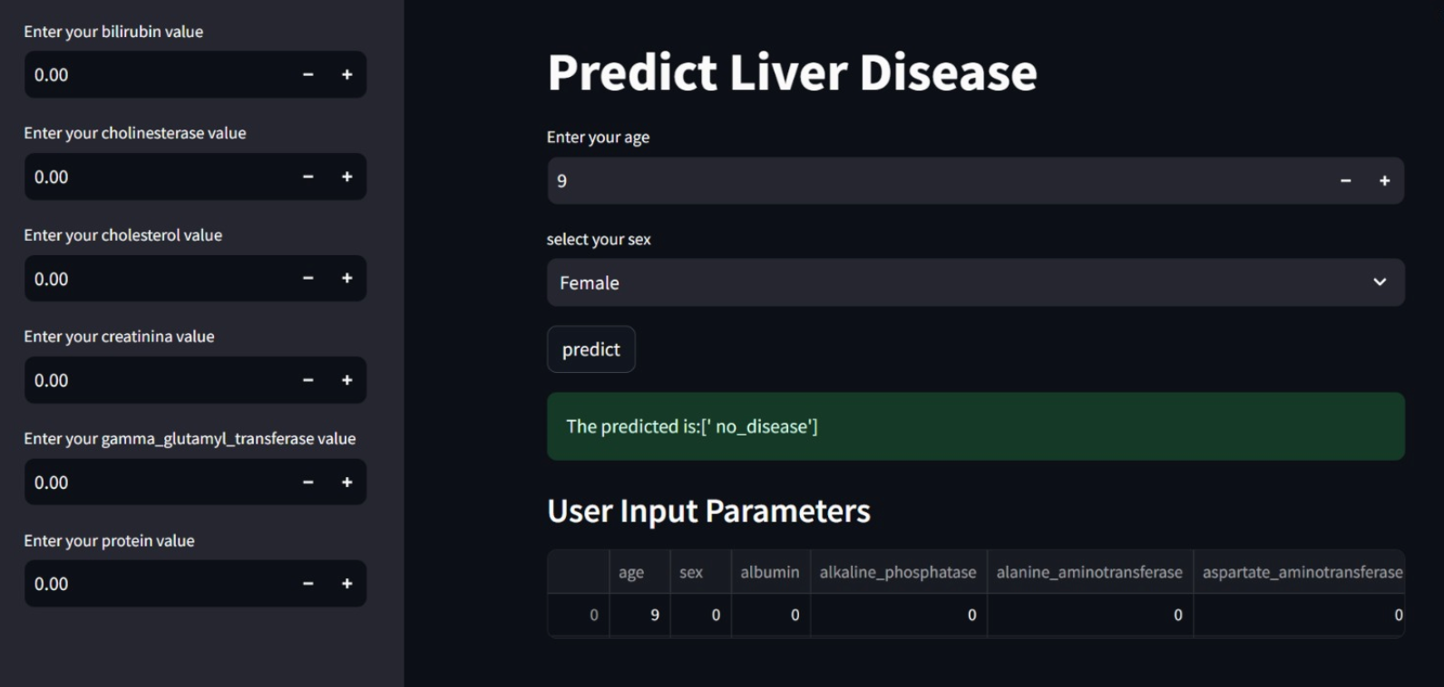

Slide 19

CONCLUSION
In conclusion, the development of a liver disease prediction model represents a significant advancement in healthcare. By leveraging advanced computational techniques and incorporating relevant risk factors, this model provides a valuable tool for early detection and proactive management of liver diseases.

Slide 20


